Slide 1


Value proposition canvas
GAIN CREATORS | What you will receive
GGAINS | What is expected or needed?
Event clustering
Incident enrichment
Reduced MTTR
Anomaly detection
Predictive analytics
Service level
monitoring
Data visualization (dashboards, charts)
Cost savings
Incident resolution
Less downtime
Dynamics thresholds
Improved collaboration
Problem management
JOBS |
What do you need to do?
OBSERVABILITY PRODUCTS, SERVICES
Log analytics
SEE NEXT SLIDE…
Complexity reduction
Service management
Alert noise
Alert noise reduction
Repetitive, manual tasks
Continuous improvement
Service dashboards
Context-rich RCA
Proactive incident management
Silos and communication gaps
Silo breaking
Connecting SMEs to the data
Reactive incident management
Time-saving
PPAINS |
What do you experience during the job?
PAIN REDUCERS | What pain we take away

Slide 2
1. Single Way to Capture Data
© 2020 S P LU N K I N C .
 |  | Telemetry “verticals”
 | Tracing | Metrics | Logs, etc
 | Instrumentation APIs | Java,C#,Python(language)
Telemetry “layers” | Canonical implementations | java,C#,Python(language)
 | Data infrastructure | collectors, sidecars, etc.
 | Interop formats | w3c trace-context, wire formats for trace data, metrics, logs, etc.

Slide 3
2. You Have Control of Your Data
© 2020 S P LU N K I N C .
receivers: otlp:
protocols: grpc:
zipkin: processors: batch: exporters:
sapm:
access_token: YOUR_TOKEN
endpoint: https://ingest.us0.signalfx.com/v2/trace service:
pipelines: traces:
receivers: [otlp, zipkin] processors: [batch] exporters: [sapm]
Extensions: health, pprof, zpages
OTLP
OTLP
Batch
...
Queued Retry
Jaeger
Receivers
Exporters
Prometheus
Processors
Prometheus
Batch
...
Queued Retry
Processors
Jaeger
Otel Collector

Slide 4
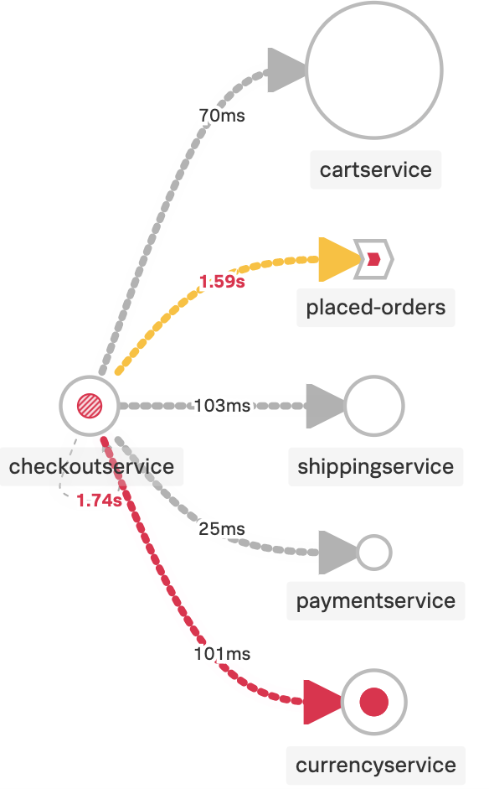
3. Context Reduces MTTR
© 2020 S P LU N K I N C .
Tracing supports the W3C trace-context format as well as Zipkin’s B3 headers (even both in parallel!)
Correlation context makes it possible to share metadata regardless of data source
Context is shared via Propagators
https://github.com/open-telemetry/opentelemetry-specification/blob/master/specification/overview.md#spancontext https://github.com/open-telemetry/opentelemetry-specification/blob/master/specification/context/context.md

Slide 5
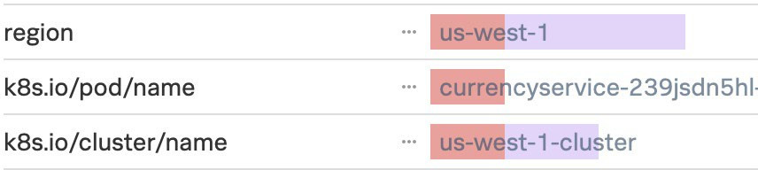
4. Open Standards = Data Portability
© 2020 S P LU N K I N C .
Semantic conventions normalize data.
HTTP: http.method, http.status_code
Database: db.instance, db.statement
Messaging: messaging.system
FaaS: faas.trigger
Resources capture environment metadata.
Application: Service, Telemetry
Compute Unit: Container, FaaS, Process
Compute Instance: Host
Environment: OS, Cloud, Deployment
Application Otel Library
Database
https://github.com/open-telemetry/opentelemetry-specification/blob/master/specification/trace/semantic_conventions/README.md https://github.com/open-telemetry/opentelemetry-specification/tree/master/specification/resource/semantic_conventions

Slide 6








5. Everyone is Contributing and Adopting
© 2020 S P LU N K I N C .
Cloud Providers
Vendors
End-users
Other
AWS | Azure | GCP
Every major vendor!
Mailchimp (PHP) Postmates (Erlang) Shopify (Ruby)
Jaeger > OtelCol Fluent-bit <3 log SIG Envoy roadmap OpenMetrics roadmap Spring roadmap
https://github.com/open-telemetry/community/blob/master/ADOPTERS.md https://medium.com/jaegertracing/jaeger-embraces-opentelemetry-collector-90a545cbc24

